Slide 1
REMINDER-A CAMPUS BUDDY
BY
ALWIN EMMANUEL
SJC17MCA003

Slide 2
ABSTRACT
Now a day’s usage of android applications has become a part of our life. By using these applications our work becomes simple and easier in our day to day activities. This paper suggests an android application which is generally useful for the students and Faculties. It contains various features like notifying the student about the subject to be studied as per day, alerting students about their examination, helps students to calculate total number of days for examination and reminds them about the subject which is lowest percentage in marks which helps to focus on that specified subject.... This application also alerts the students and faculties about various events like examinations, workshops to be held, student activities to be conducted etc. This application is user friendly and can be installed in any android smart phone..An Android App which helps students and teachers to remind and schedule various education activities...so that it helps to optimize the time.......

Slide 3
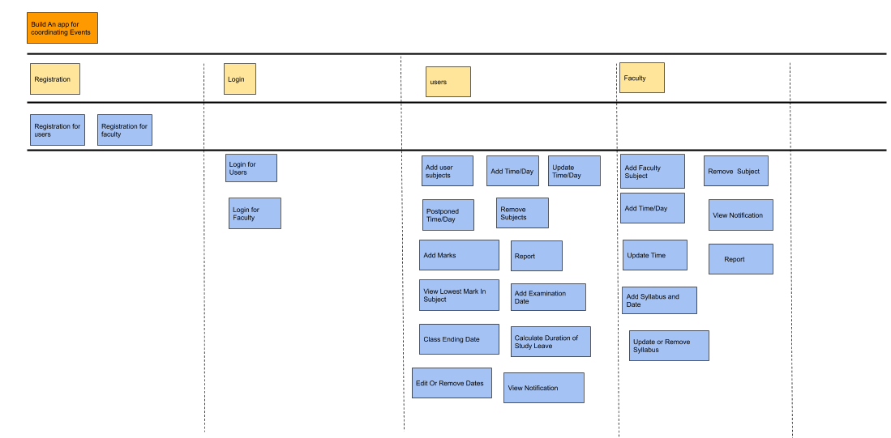
USER STORY

Slide 4
TABLE DESIGN
Faculty Registration
Field Name | Data Type | Description | Constraint
Username | Varchar(50) | Name of Faculty | NOT NULL
ID | Integer | Faculty ID | UNIQUE
Mobile Number | Integer | Contact Number of Faculty | NOT NULL
Department | Varchar(50) | Department | NOT NULL
Email | Varchar(50) | E - mail Id | NOT NULL
Password | Varchar(50) | Password | NOT NULL

Slide 5
Student Registration
Field Name | Data Type | Description | Constraint
Username | Varchar(50) | Name of Student | NOT NULL
ID | Integer | Student ID | UNIQUE
Mobile Number | Integer | Contact Number of Student | NOT NULL
Department | Varchar(50) | Department | NOT NULL
Email | Varchar(50) | E - mail Id | NOT NULL
Password | Varchar(50) | Password | NOT NULL

Slide 6
Time Table
Field Name | Data Type | Description | Constraints
Username | Varchar(50) | Name | NOT NULL
Semester | Varchar(50) | Semester | NOT NULL
Subject | Varchar(50) | Subject | NOT NULL
Module | Varchar(50) | Module | NOT NULL
Topic | Varchar(50) | Topic | NOT NULL
Day | Varchar(50) | Day | NOT NULL
Time | Integer | Time | UNIQUE

Slide 7
Notification
Field Name | Data Type | Description
Date | Date | Date
Message | Varchar(50) | Faculty:Syllabus updation,Time schedule,postponed date.... Student:Exam Information, Daily Time table,postponed subject...

Slide 8
Exam
Field Name | Data Type | Description | Constraint
Username | Varchar(50) | Name of Student | NOT NULL
ID | Integer | Student ID | UNIQUE
Subject | Varchar(50) | Subject Name | NOT NULL
Mark | Integer | Mark | NOT NULL

Slide 9
DATA FLOW DIAGRAM

Slide 10
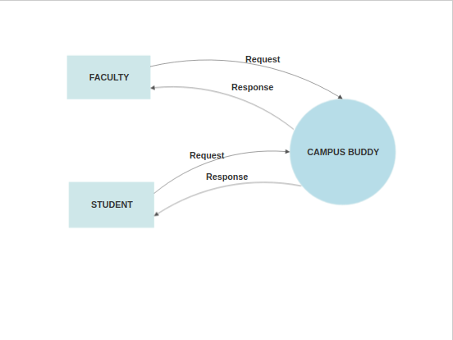
Context Level DFD

Slide 11
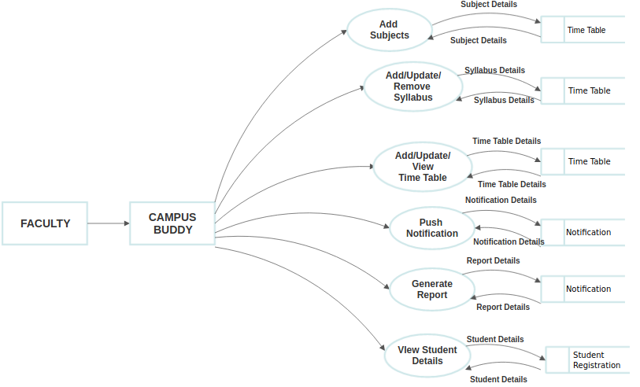
Level 1 DFD- Faculty

Slide 12
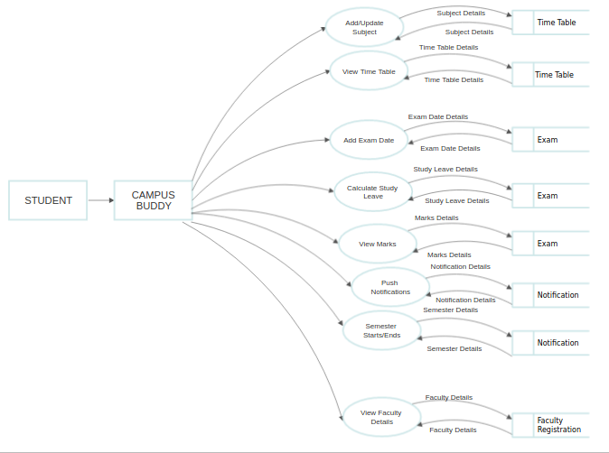
Level 1 DFD- Student

Slide 13
USER INTERFACE/SCREEN SHOT

Slide 14
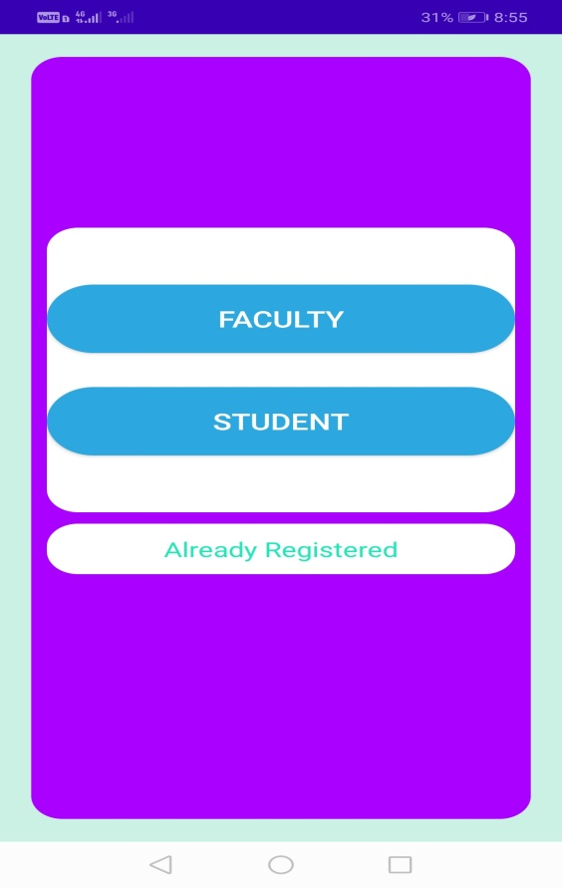
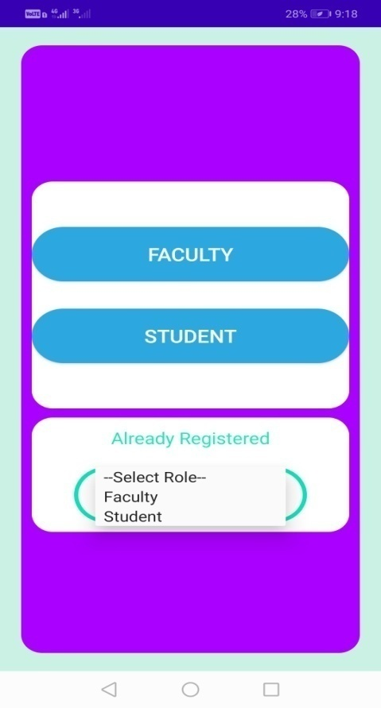
LOGIN FORM

Slide 15
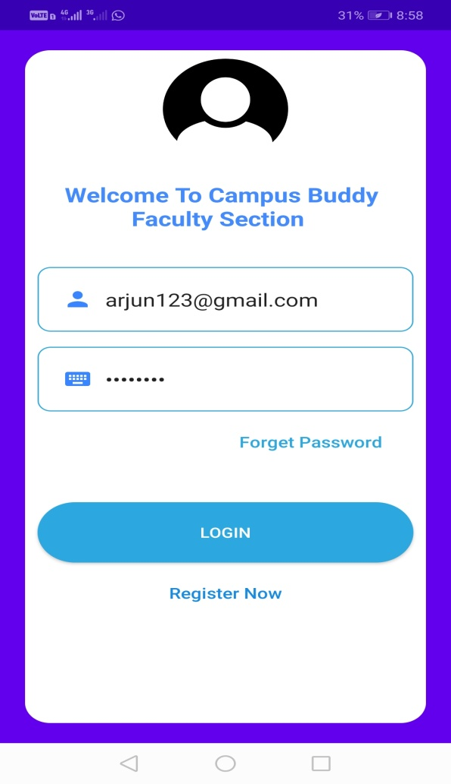
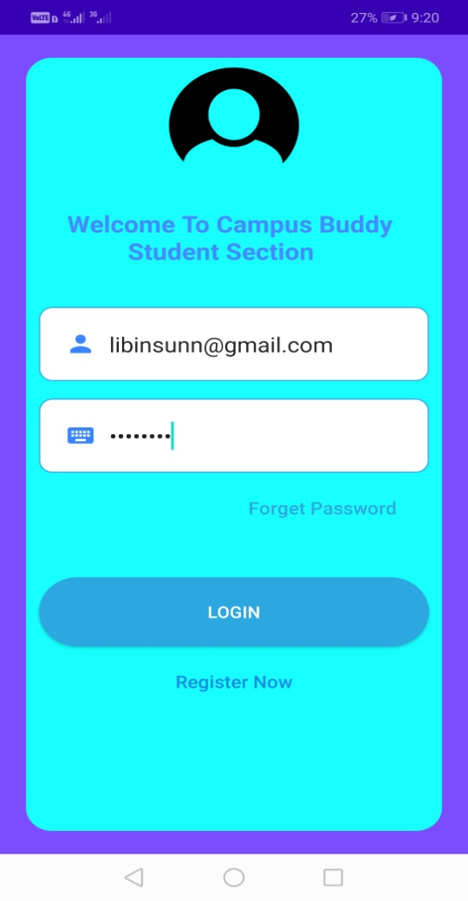
Login page for faculty and student

Slide 16
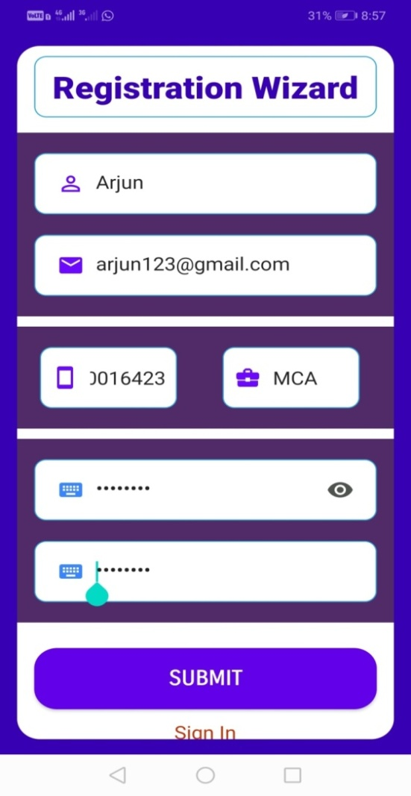
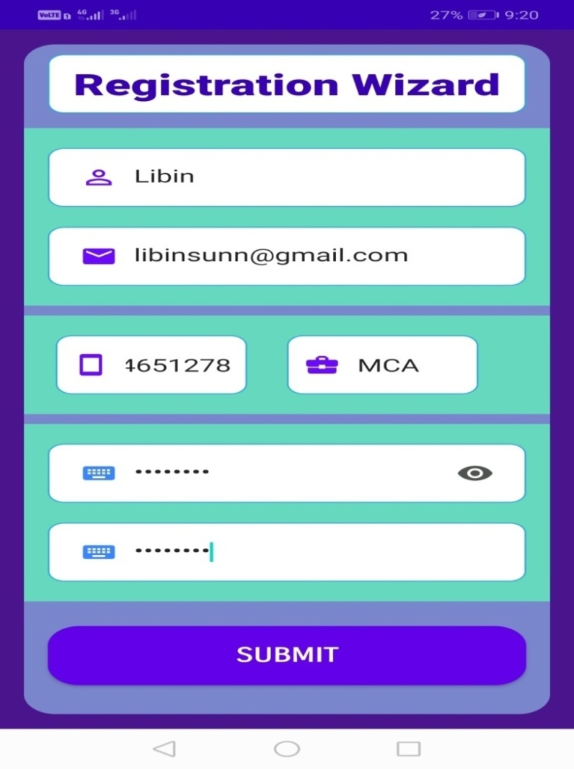
Faculty/Student Registration Wizard

Slide 17
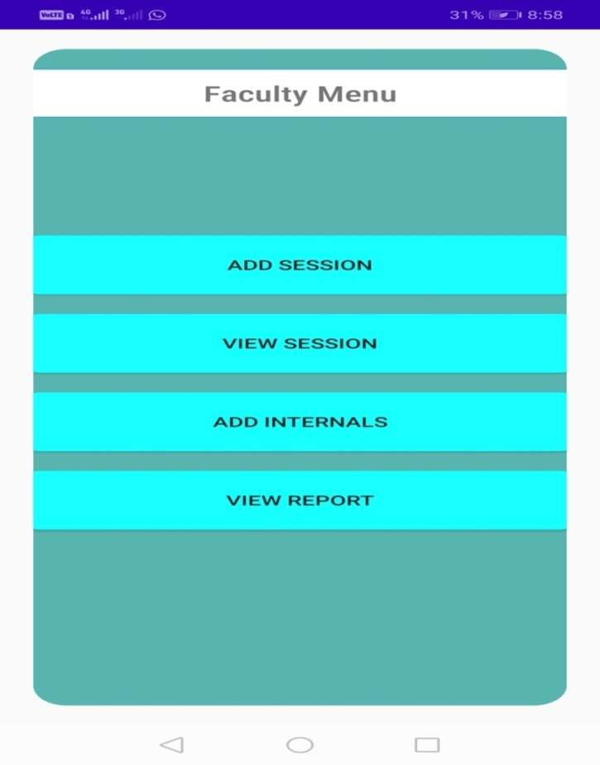
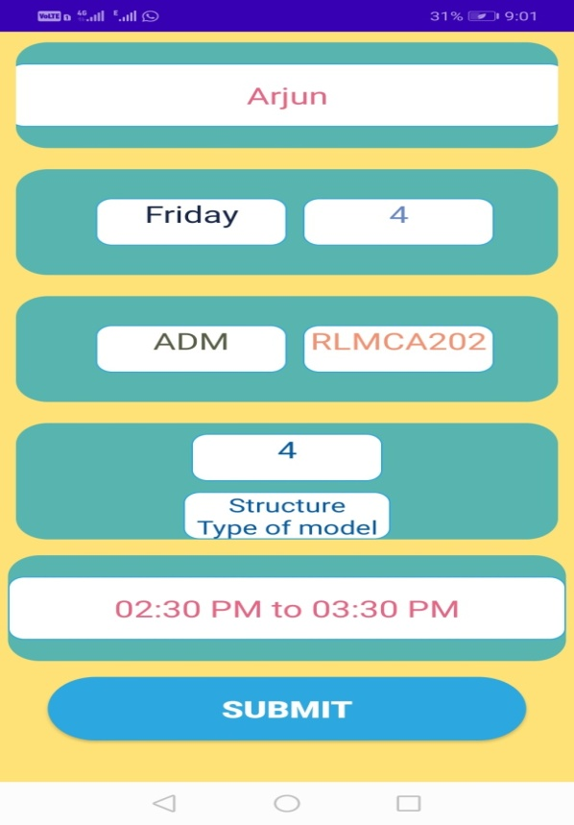
Faculty Profile
Faculty Menu

Slide 18
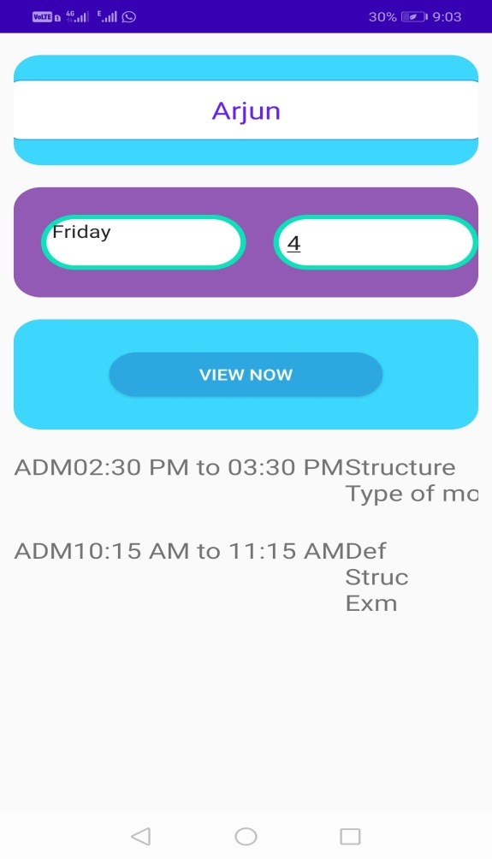
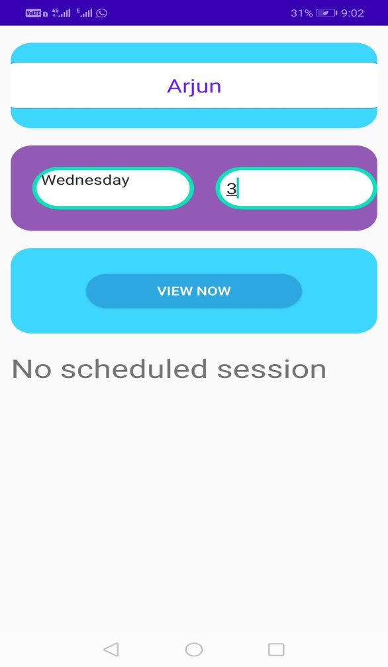
View Faculty Session

Slide 19
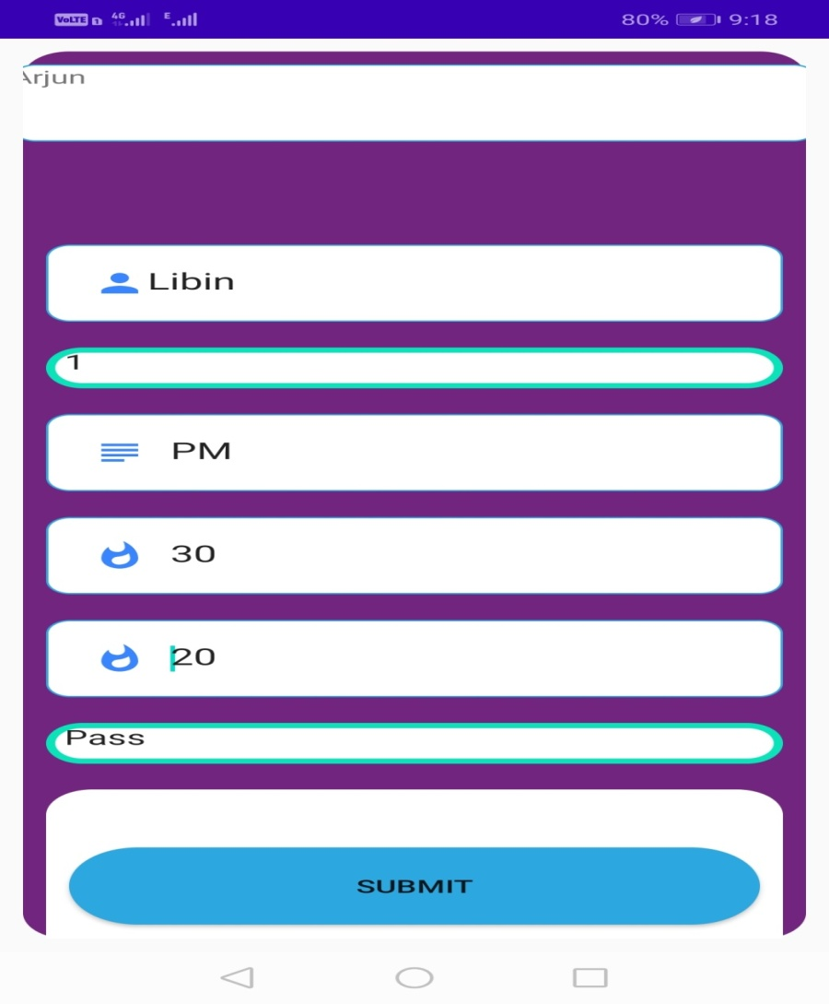
Adding Internals

Slide 20
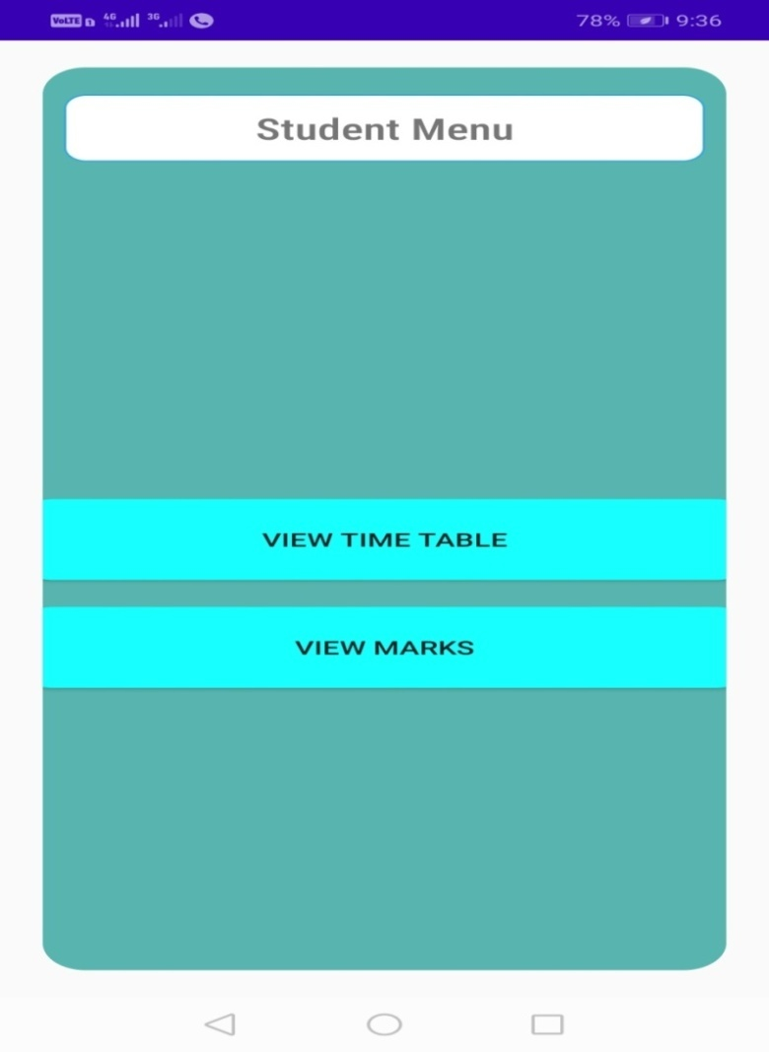
Student Menu

Slide 21
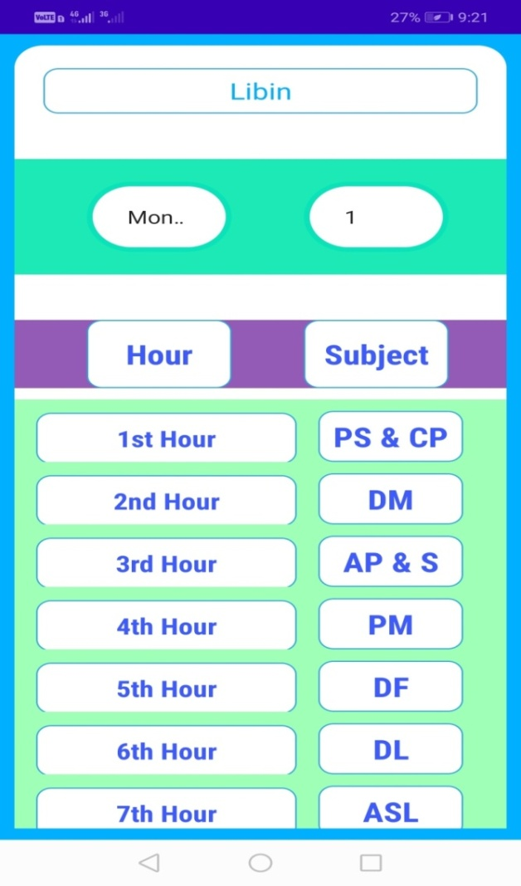
View Timetable For Student

Slide 22
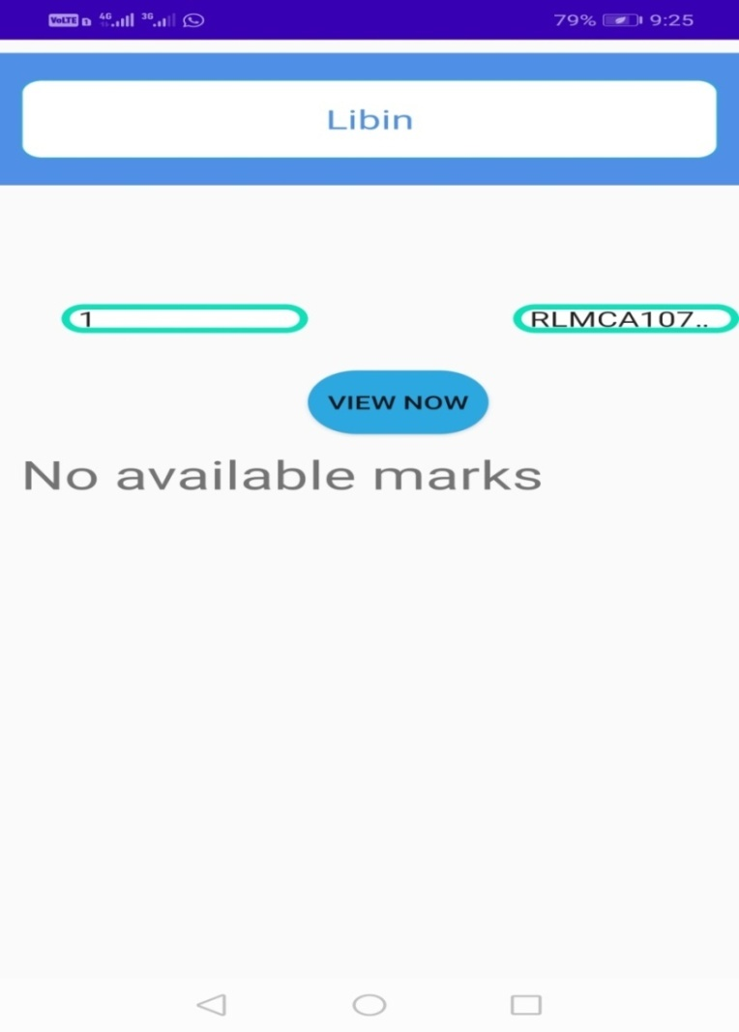
View Internal Mark For Student

